Slide 1

and know why it works
Dimitris Papailiopoulos
Let Your Cores Run Wild!

Slide 2
Overview
SGD and Convergence Rates
Hogwild!:
Asynchronous and Lock-free SGD
Challenges in analysis
How to overcome them
How far can Hogwild! go?

Slide 3
ML Pipelines
Test Data
Input Data
Feature
and Model Selection
Training
Model

Slide 4
ML Pipelines
Test Data
Input Data
Feature Selection
Training
Model
Google’s deep nets can take weeks to train
[Dean et al., 2012]

Slide 5
Solvability ≠ Scalability
Many of the problems that we visit, can be solved in polynomial time, but that’s not enough.
E.g.,
O( #examples^4 * dimension^5 ) not scalable
We need fast algorithms!
Ideally O(#examples * #dimension) time
We want algorithms amenable to parallelization!
if serial runs in O(T) time, we want O(T/P) on P cores.

Slide 6
Performance Trade-off
We want our algorithms to be here
stat. accuracy
speed
parallelizability

Slide 7
SGD:
The Über-algorithm

Slide 8


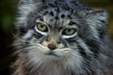



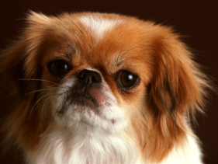



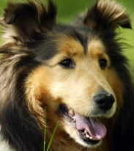

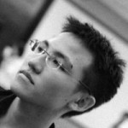
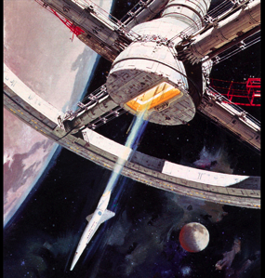


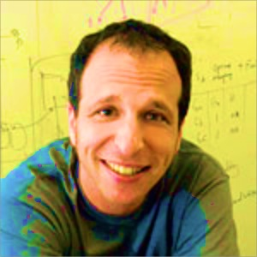

Classification
Topic Modeling
Why is it raining??
I love the rain <3
<3 this game #Go Warriors
All Solved by an Über-algorithm
The Warriors Rock!
Feel the Bern!
Matrix Completion
DeepNets
Spectral Analysis
Graph Clustering

Slide 9
Stochastic Gradient Descent
Goal: Minimize losses
Idea (‘50s, ‘60s [Robbins, Monro], [Widrow, Hoff]):
Sample a data point + locally optimize.
loss for data point i
SGD: An Über-algorithm

Slide 10
SGD: the Über-algorithm
Data points
Model
1
Sample
2
2
3
4
Step1: Pick random data point

Slide 11
SGD: the Über-algorithm
Data points
Model
1
Read
2
3
4
Step 2:
Read Variables

Slide 12
SGD: the Über-algorithm
Data points
Model
1
Compute grad. of local loss
2
3
4
Step3:
Compute local function

Slide 13
SGD: the Über-algorithm
Different names and flavors
ML / Optimization / Statistics / EE
Perceptron
Incremental Gradient
Back Propagation (NNs)
Oja’s iteration (PCA)
LMS Filter
…
Has been around for a while, for good reasons:
Robust to noise
Simple to implement
Near-optimal learning performance
Small computational foot-print
- Stable
Data points
Model
1
Update Model
2
3
4
Step4:
Update Model

Slide 14
SGD can take 100s hrs on large data sets
[Dean et al, Google Brain]
Goal:
Parallelize this

Slide 15
Scaling Up SGD

Slide 16
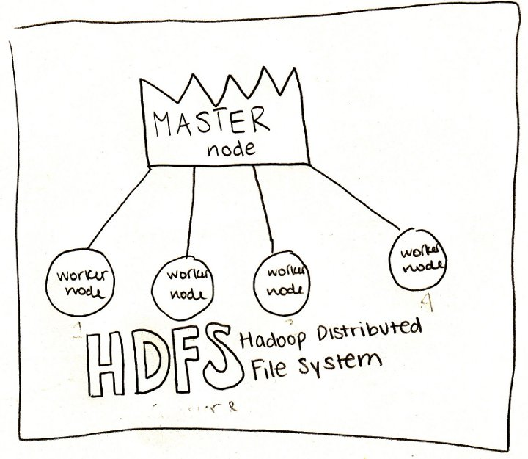
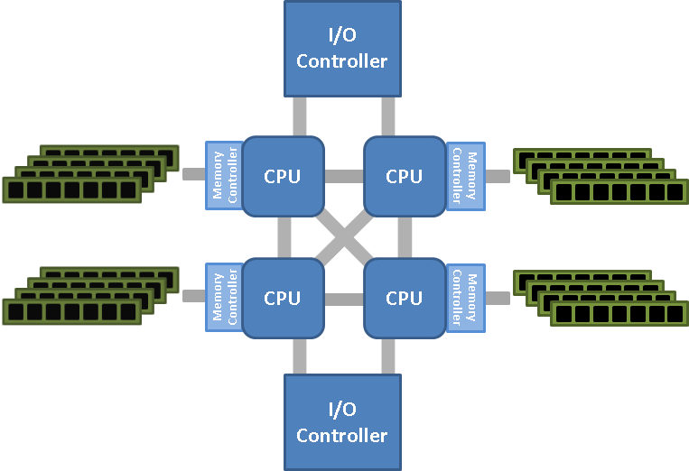
Platforms
Distributed Data-centers
Parallel
Single machine, multicore
Multi-socket NUMA
Distributed

Slide 17
Today
Single Machine, Multi-core

Slide 18
How to Parallelize
Parallelize computation of one update?
Issue:
computing cheap (even for deep nets) [ O(d) ]
Parallel Updates?
Issue: SGD is inherently serial….
Q: Can we parallelize inherently serial algorithms?

Slide 19
SGD on sparse functions
Def:
Hyperedge = the subset of variables that depends on
The function-variable graph
Matrix Fact./Comp.
Graph cuts
Graph/text Classification
Topic Modeling
Dropout
…

Slide 20

Challenges in Parallel SGD
data points
shared variables
No conflict =>
2 parallel iterations = 2 serial iterations

Slide 21
Challenges in Parallel SGD
data points
shared variables
No conflict => Speedup

Slide 22
Challenges in Parallel SGD
data points
shared variables
oops, conflicts
What should we do for conflicts?
Approach 1: Coordinate or Lock
Approach 2: Don’t Care (Lock-free Async.)

Slide 23

Prior (2011) Work
Long line of theoretical work since the 60s [Chazan, Miranker, 1969]
Foundational work on Asynchronous Optimization Master/Worker model [Tsitsiklis, Bertsekas, 1986, 1989]
Recent hardware/software advances renewed the interest Round-robin approach [Zinkevich, Langford, Smola, 2009] Average Runs [Zinkevich et al., 2009], Average Gradients [Duchi et al, Dekel et al. 2010]
Many based on “Coordinate” or “Lock” approach
Why Coordinate or Lock?
Issue: Synchronization and comm. overheads

Slide 24
A case against Synchronization
overheads
timeline
CPU 1
CPU 2
CPU 3
stragglers
Asynchronous World
CPU 1
CPU 2
Faster
CPU 3
Easier to Implement

Slide 25
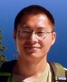
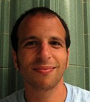



HOGWILD! 2011
“Run parallel lock-free SGD without synchronization”
Niu
Recht
Ré
Wright
SVM RCV1 (10 cores)
Each processor in parallel
Impact
Downpour SGD, Project Adam use HOGWILD!
Renewed interest on async. optimization

Slide 26
Challenges in Analysis

Slide 27
Challenges in Hogwild!
Shared Memory
Processor 1
Issues:
1. updates can be old
2. results can overwritten
Processor 2
Processor P
Incompatible with classic SGD analysis

Slide 28
How to analyze parallel algorithms?
Main measure of performance
Example: Gradient Descent
Embarrassingly Parallel O(#cores) speedup
Serial
Parallel
Not true for Parallel SGD
- Convergence is invariant of allocation
Both algorithms reach to same accuracy after T iterations
Speedup is independent of covergence rate

Slide 29
How to Analyze Hogwild?
Measure of performance
Goal of a Hogwild Analysis
Prove that Parallel SGD and Serial SGD have similar convergence rates for given number of samples
Assumption:
random sampling of gradients yields a nearly optimal load balance
(if number of cores not too many)

Slide 30
How to Analyze Hogwild?
- [Niu, Recht, Re, and Wright, 2011] the first analysis of Hogwild! Issues:
- many impractical assumptions
- simplified read/write model
[consistent reads, single coordinate updates, …]
- lengthy derivations
Many Async. algorithms follow using similar assumptions, and/or analysis:
[Duchi et al, 2011], [Liu et al, 2014, 2015], [Avron et al. 2014],
[De Sa et al, 2015], [Lian et al., 2015], [Peng et al., 2015]

Slide 31
How to Analyze?
General Framework for
Asynchronous Lock-free Algorithms?
- [Niu, Recht, Re, and Wright, 2011] give the first
convergence analysis of Hogwild! Issues:
- (over) simplified read/write model. [consistent reads, single coordinate updates, etc]
- lengthy derivations
Several Async+lock-free algorithms follow
using similar assumptions, and/or analysis:
- [Duchi et al, 2011], [Liu et al, 2014, 2015], [Avron et al. 2014], [De Sa et al, 2015], [Lian et al., 2015], [Peng et al., 2015]

Slide 32
Analyzing Asynchronous Schemes

Slide 33
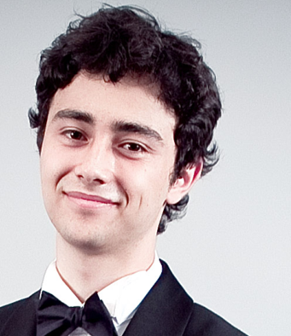



A Noisy Lens for Asynchronous Algorithms
Main Idea
Noisy viewpoint:
Asynchronous(Algo.( INPUT )) Serial(Algo.(INPUT + Noise)
Perturbed Iterate Analysis for Asynchronous Stochastic Optimization
[Mania, Pan, P, Recht, Ramchandran, Jordan, 2015]
Joint work with

Slide 34
HOGWILD! as noisy SGD
Each processor in parallel
Def: is the k-th sampled data point
Fact: Cores don’t read “actual” iterates but “noisy iterates”
After T processed samples, the contents of RAM are:
(atomic writes + commutativity)
Ex.

Slide 35
HOGWILD! as noisy SGD
Each processor in parallel
Def: is the k-th sampled data point
Fact: Cores don’t read “actual” iterates but “noisy iterates”
After T processed samples, the contents of RAM are:
(atomic writes + commutativity)
Ex.
Core 1
Core 2
Core 3
RAM
1
0
0
050
017
000

Slide 36
HOGWILD! as noisy SGD
Each processor in parallel
Def: is the k-th sampled data point
Fact: Cores don’t read “actual” iterates but “noisy iterates”
After T processed samples, the contents of RAM are:
(atomic writes + commutativity)
Ex.
Core 1
Core 2
Core 3
RAM
1
0
0
050
017
000

Slide 37
HOGWILD! as noisy SGD
Each processor in parallel
Def: is the k-th sampled data point
Fact: Cores don’t read “actual” iterates but “noisy iterates”
After T processed samples, the contents of RAM are:
(atomic writes + commutativity)
Ex.
Core 1
Core 2
Core 3
RAM
1
0
0
050
017
050

Slide 38
HOGWILD! as noisy SGD
Each processor in parallel
Def: is the k-th sampled data point
Fact: Cores don’t read “actual” iterates but “noisy iterates”
After T processed samples, the contents of RAM are:
(atomic writes + commutativity)
Ex.
Core 1
Core 2
Core 3
RAM
1
0
0
050
017
050

Slide 39
HOGWILD! as noisy SGD
Each processor in parallel
Def: is the k-th sampled data point
Fact: Cores don’t read “actual” iterates but “noisy iterates”
After T processed samples, the contents of RAM are:
(atomic writes + commutativity)
Ex.
Core 1
Core 2
Core 3
RAM
1
0
0
050
017
150

Slide 40
HOGWILD! as noisy SGD
Each processor in parallel
Def: is the k-th sampled data point
Fact: Cores don’t read “actual” iterates but “noisy iterates”
After T processed samples, the contents of RAM are:
(atomic writes + commutativity)
Ex.
Core 1
Core 2
Core 3
RAM
1
0
0
050
017
160

Slide 41
HOGWILD! as noisy SGD
Each processor in parallel
Def: is the k-th sampled data point
Fact: Cores don’t read “actual” iterates but “noisy iterates”
After T processed samples, the contents of RAM are:
(atomic writes + commutativity)
Ex.
Core 1
Core 2
Core 3
RAM
1
0
0
050
017
167

Slide 42
HOGWILD! as noisy SGD
Each processor in parallel
Def: is the k-th sampled data point
Fact: Cores don’t read “actual” iterates but “noisy iterates”
After T processed samples, the contents of RAM are:
(atomic writes + commutativity)
The algorithmic progress is captured by ``phantom” iterates
Main Questions:
Where does noise come from?
How strong is it?

